Slide 1

















KIP tech Co., Ltd.
SIGN IN
11:11 AM

Slide 2















My team
Class Diagram
Panyarat Kenwithee
650710566
Pornkamol Earpin
650710570
to do list
Worawarun Pliansri
650710581
Demonstration
Elevator Project
Example
11:11 AM
16/8/2023

Slide 3


Demo
Button1
Button2
Class Diagram
Passenger
Demonstration
Elevator
Controller
Example
11:11 AM
16/8/2023

Slide 4

Button1
Class Diagram
-floor: int
-direction: string
-controller: Controller
Demo
Button1
Button2
Demonstration
+setController()
+sendFloor()
Passenger
Elevator
Controller
Example
11:11 AM
16/8/2023

Slide 5

Button2
Class Diagram
-elevator: Elevator
-controller: Controller
-currentFloor: int
Demo
Button1
Button2
Demonstration
+selectFloor()
+extend()
Passenger
Elevator
Example
Controller
11:11 AM
16/8/2023

Slide 6
Demo
Class Diagram
Passenger
Button1
Button2
-weight: int
Passenger
Demonstration
Elevator
+callElevator()
Controller
Example
11:11 AM
16/8/2023

Slide 7
Controller
Demo
Button1
Button2
-size: int
Class Diagram
+selectLift()
+print()
Passenger
Elevator
Controller
Demonstration
Example
11:11 AM
16/8/2023

Slide 8
Elevator
Demo
-ID: string
-maxLoad: int
-currentFloor: int
-direction: string
-status: boolean
-cont: Controller
Button1
Button2
Class Diagram
Passenger
Elevator
Controller
+getID()
+newCurrentFloor()
+getCurrentFloor()
+openDoor()
+closeDoor()
+goUp()
+goDown()
Demonstration
Example
11:11 AM
16/8/2023

Slide 9
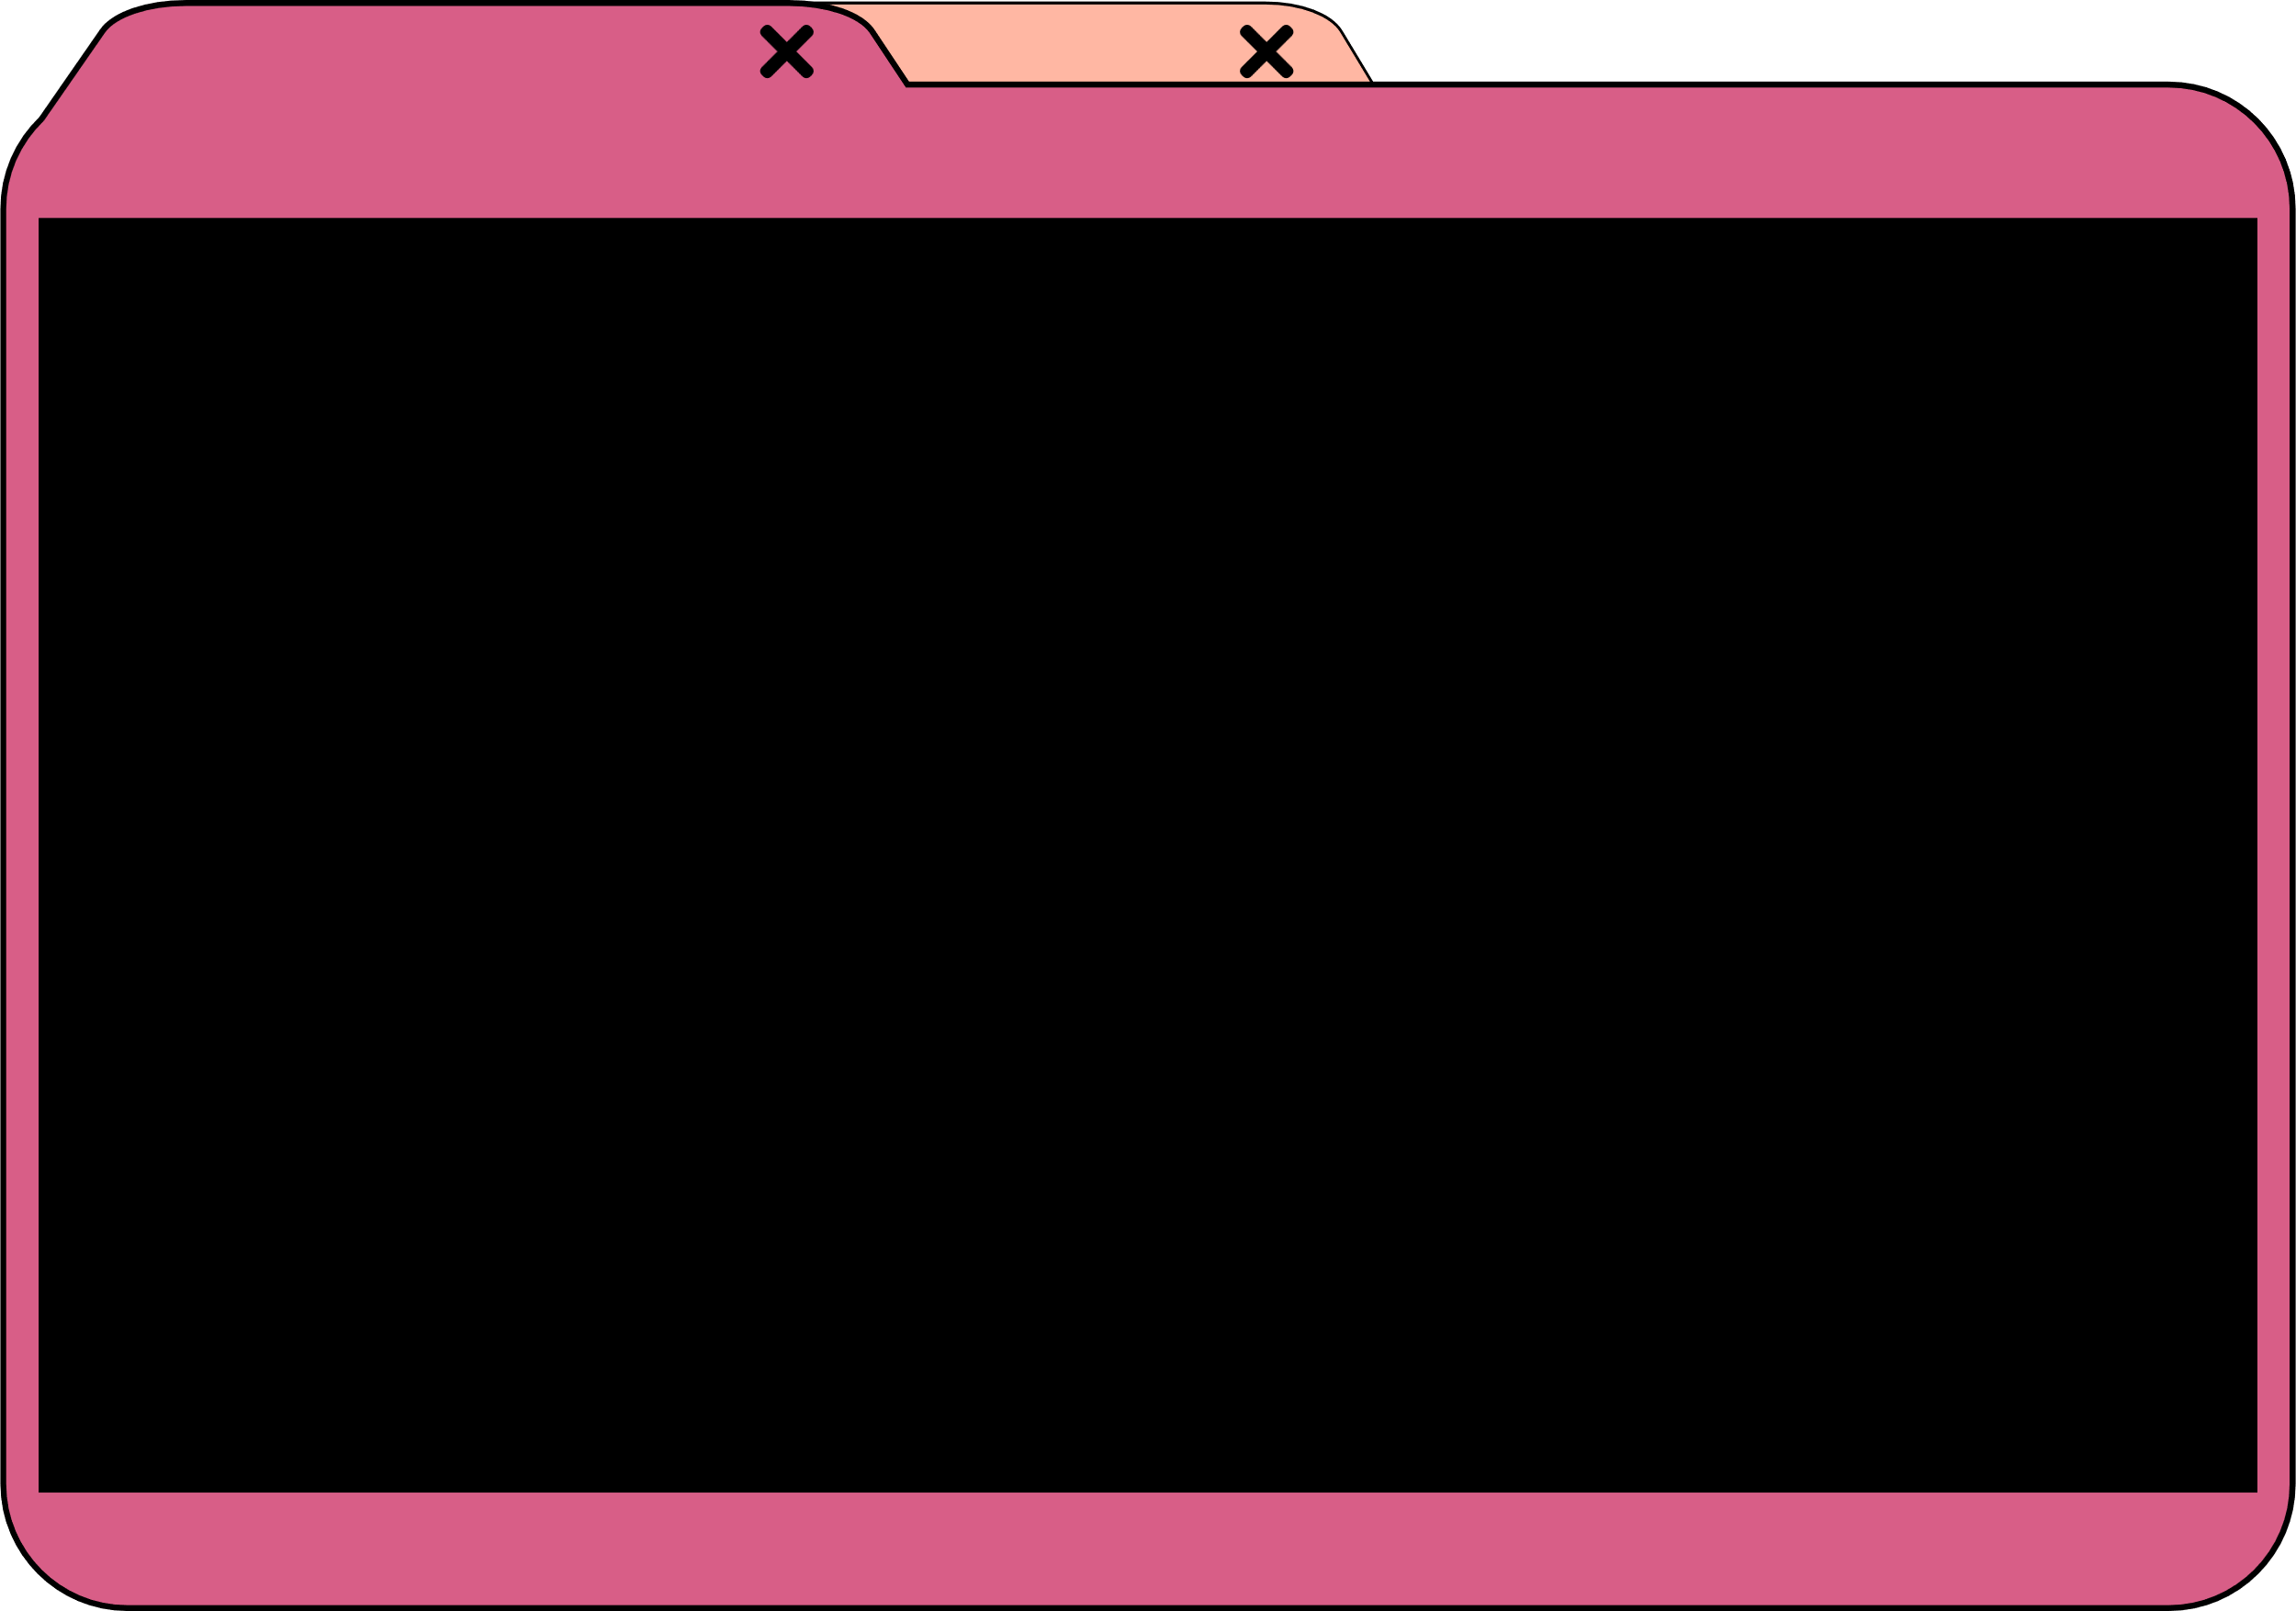

public class Demo {
public static void test(){
Button2 b2 = new Button2();
Elevator e1 = new Elevator("Elevator 1",1000,5,true);
Elevator e2 = new Elevator("Elevator 2",1000,5,true);
Controller c = new Controller();
//first p in 1 go 3
Passenger p1 = new Passenger(45);
Button1 lift1up = new Button1(1,"UP");
b2.selectFloor(3);
c.selectLift(e1);
System.out.println(e1.getID()+"'s current floor is on "+e1.getCurrentFloor()+" floor.");
System.out.println(e1.getID() + " is called from " + lift1up.sendFloor() +" floor.");
System.out.print("Now, "+ e1.getID() + " is on " + lift1up.sendFloor() + " floor and ");
c.print(lift1up,b2,e1);
System.out.println(e1.openDoor());
System.out.println(e1.getID()+ " current floor is "+e1.newCurrentFloor(b2)+" floor."); System.out.println(e1.closeDoor());
System.out.println("-----------------------------");
//second p in 6 go 2
Passenger p2 = new Passenger(52);
Button1 lift6down = new Button1(6,"DOWN");
b2.selectFloor(2);
c.selectLift(e1);
System.out.println(e2.getID()+"'s current floor is on "+e2.getCurrentFloor()+" floor.");
System.out.println(e2.getID() + " is called from " + lift6down.sendFloor() +" floor.");
System.out.print("Now, "+ e2.getID() + " is on " + lift6down.sendFloor() + " floor and ");
c.print(lift6down,b2,e2);
System.out.println(e2.openDoor()); System.out.println(e2.getID()+ " current floor is "+e2.newCurrentFloor(b2)+" floor.");
System.out.println(e2.closeDoor());
System.out.println("-----------------------------");
//third p in 8 go 1
Passenger p3 = new Passenger(48);
Button1 lift8down = new Button1(8,"DOWN");
b2.selectFloor(1);
c.selectLift(e1);
System.out.println(e1.getID()+"'s current floor is on "+e1.getCurrentFloor()+" floor.");
System.out.println(e1.getID() + " is called from " + lift8down.sendFloor() +" floor. ");
System.out.print("Now, "+ e1.getID() + " is on " + lift8down.sendFloor() + " floor and ");
c.print(lift8down,b2,e1);
System.out.println(e1.openDoor());
System.out.println(e1.getID()+ " current floor is "+e1.newCurrentFloor(b2)+" floor."); System.out.println(e1.closeDoor());
System.out.println("-----------------------------");
}
}
Elevator 1 is ready.
Elevator 1's current floor is on 5 floor.
Elevator 1 is called from 1 floor.
Now, Elevator 1 is on 1 floor and is going up to 3 floor.
Elevator Door is Open.
Elevator 1 current floor is 3 floor.
Elevator Door is Close.
-----------------------------
Elevator 2 is ready.
Elevator 2's current floor is on 5 floor.
Elevator 2 is called from 6 floor.
Now, Elevator 2 is on 6 floor and is going down to 2 floor.
Elevator Door is Open.
Elevator 2 current floor is 2 floor.
Elevator Door is Close.
-----------------------------
Elevator 1 is ready.
Elevator 1's current floor is on 3 floor.
Elevator 1 is called from 8 floor.
Now, Elevator 1 is on 8 floor and is going down to 1 floor.
Elevator Door is Open.
Elevator 1 current floor is 1 floor.
Elevator Door is Close.
-----------------------------
Class Diagram
Demonstration
Example
11:11 AM
16/8/2023

Slide 10

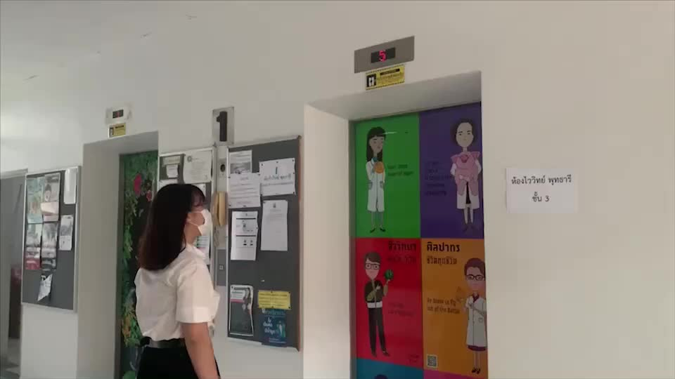
Class Diagram
Demonstration
Example
11:11 AM
16/8/2023

